Slide 1
Socially Relevant Project
Guide: Sai Ramesh sir

Slide 2
Disease Prediction System
Using machine learning and flask

Slide 3
Team members
Adhithyaa M - 2019115007
Sheikh Ameenul Haji - 2019115094

Slide 4
Abstract
Taking Maximum of five symptoms from the user ,and minimum of one classify the a disease based on the symptom given by the user
Each CSV file has 133 columns. 132 of these columns are symptoms that a person experiences and last column is the prognosis.
These symptoms are mapped to 42 diseases you can classify these set of symptoms to.
Also finds, Nearest doctor based on the current location

Slide 5
Approach
Gathering the data
Cleaning the data
Model Building
Predicting Score

Slide 6
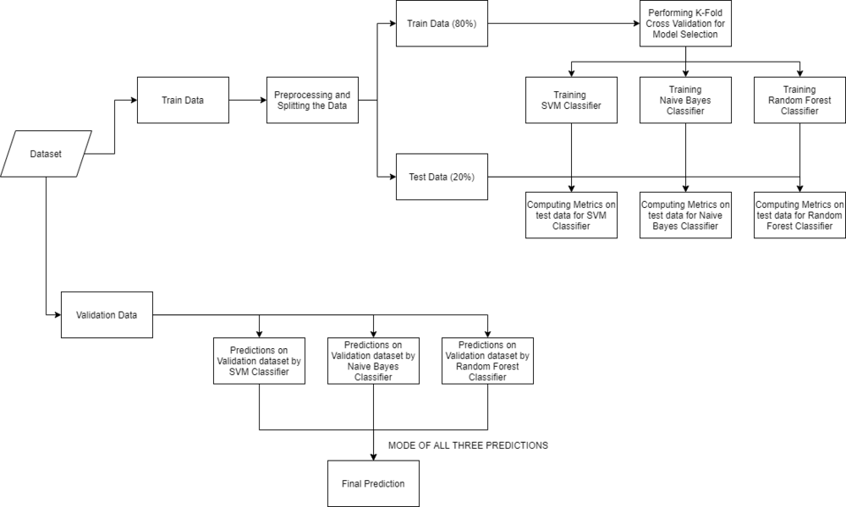
Workflow for implementation

Slide 7
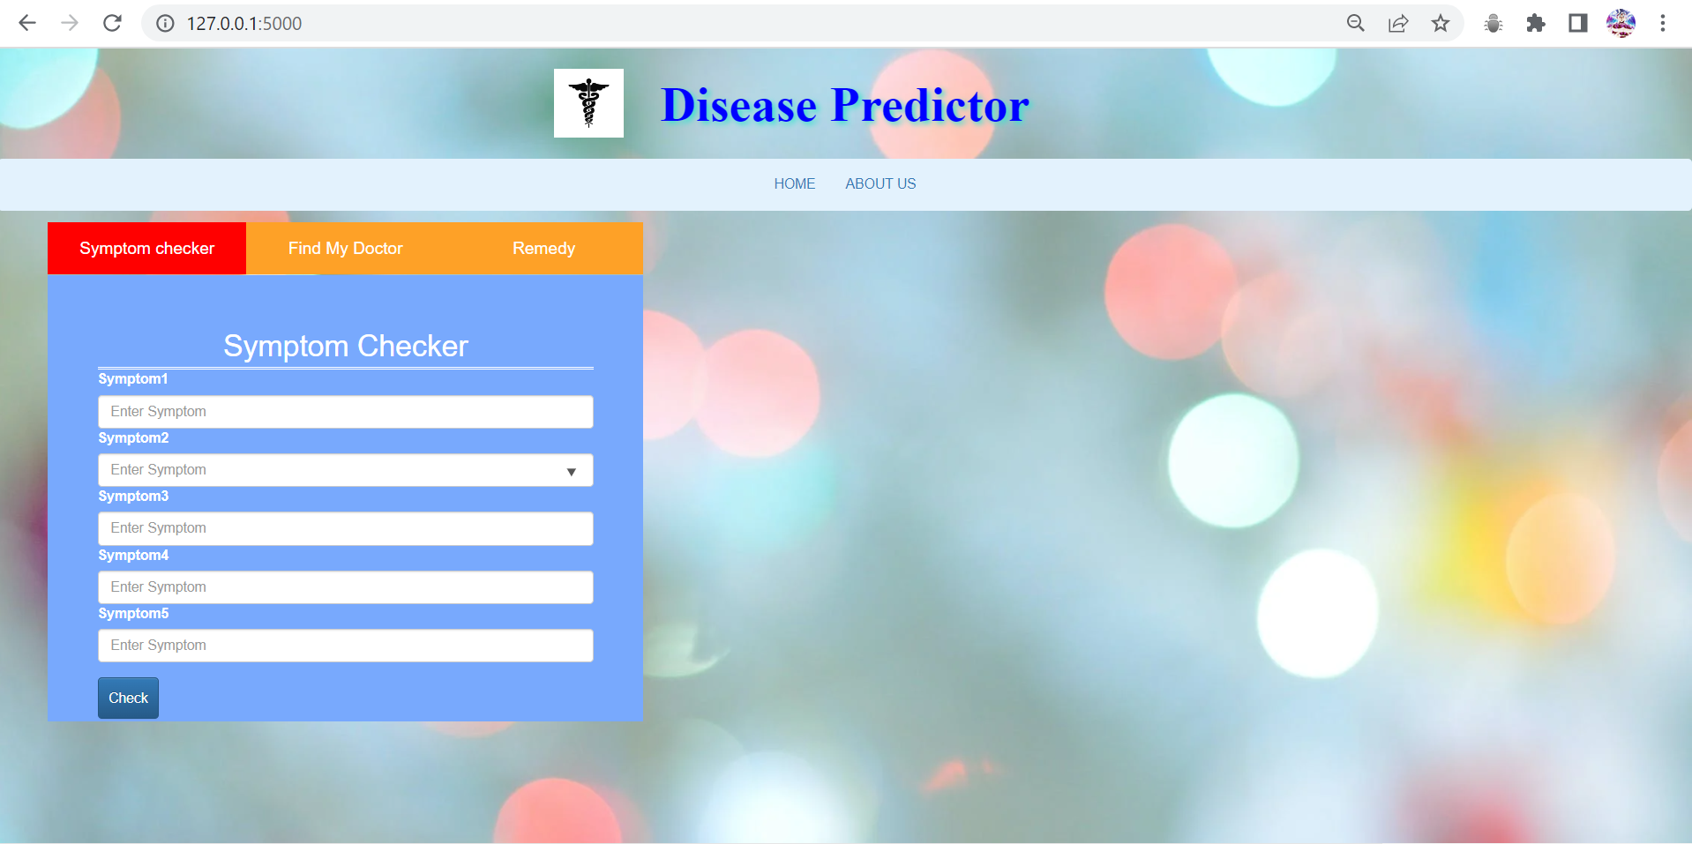
Home Page

Slide 8
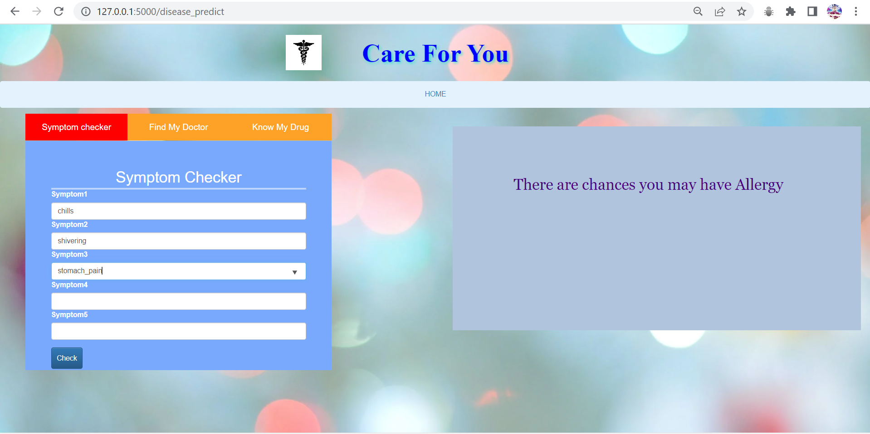
Classification of symptoms using ML Model

Slide 9
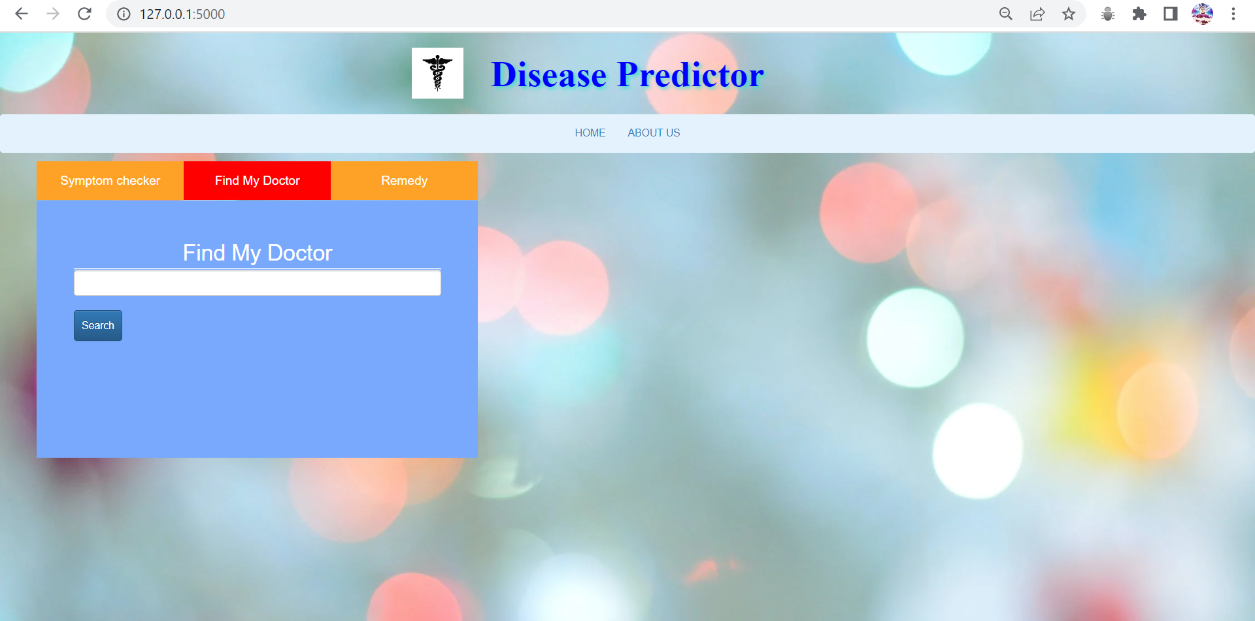
Find My Doctor

Slide 10
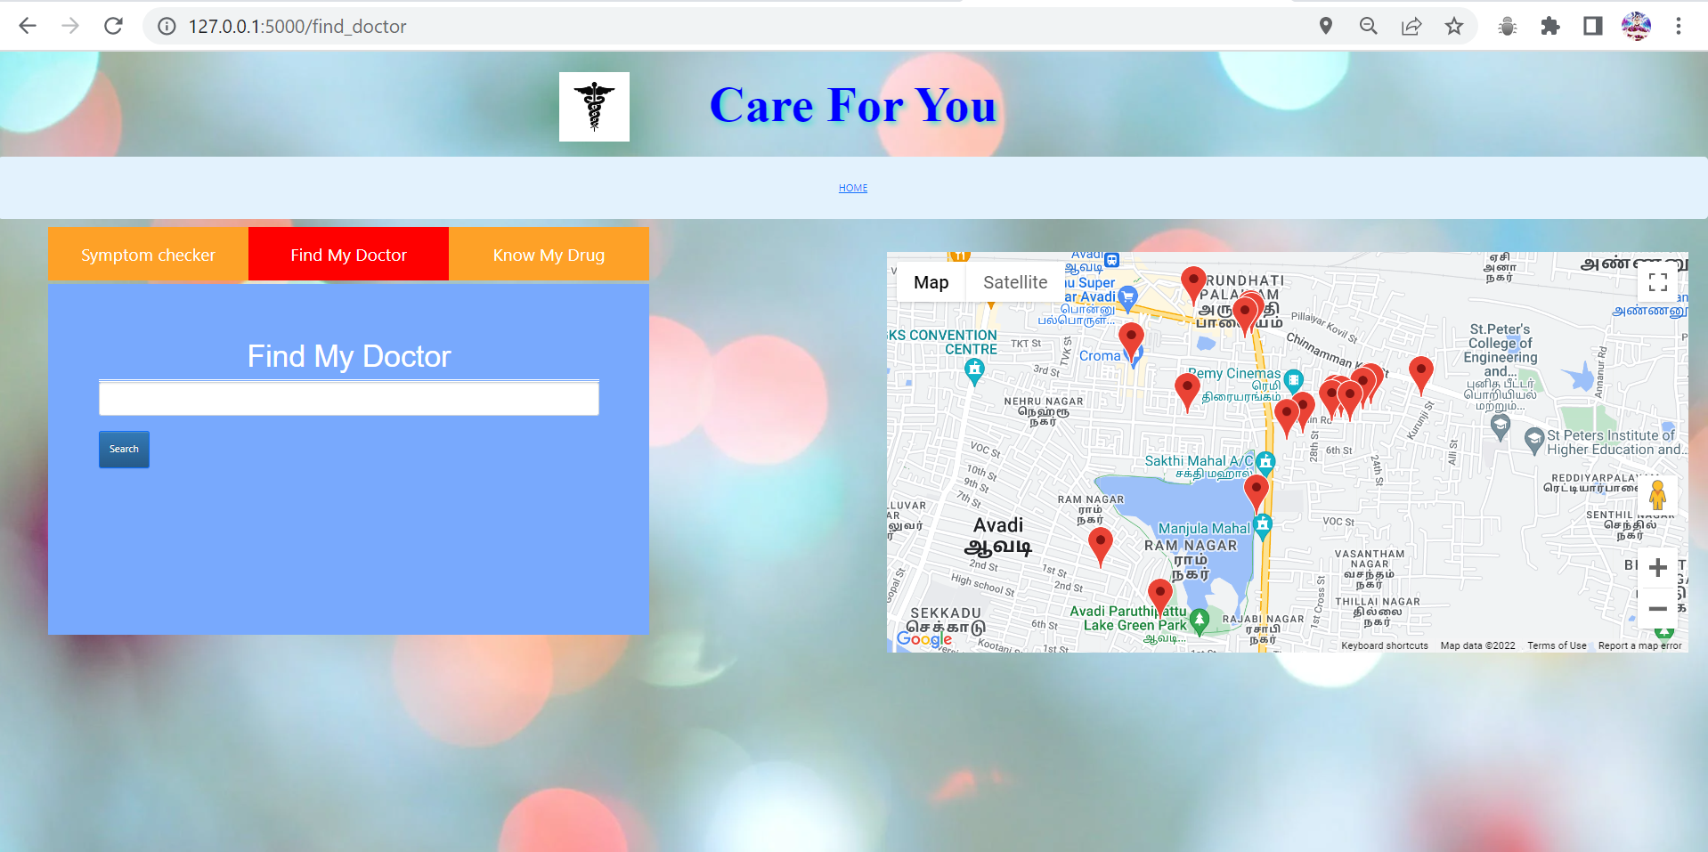
If you simply search ,it will show all hospital at a radius of 4km

Slide 11
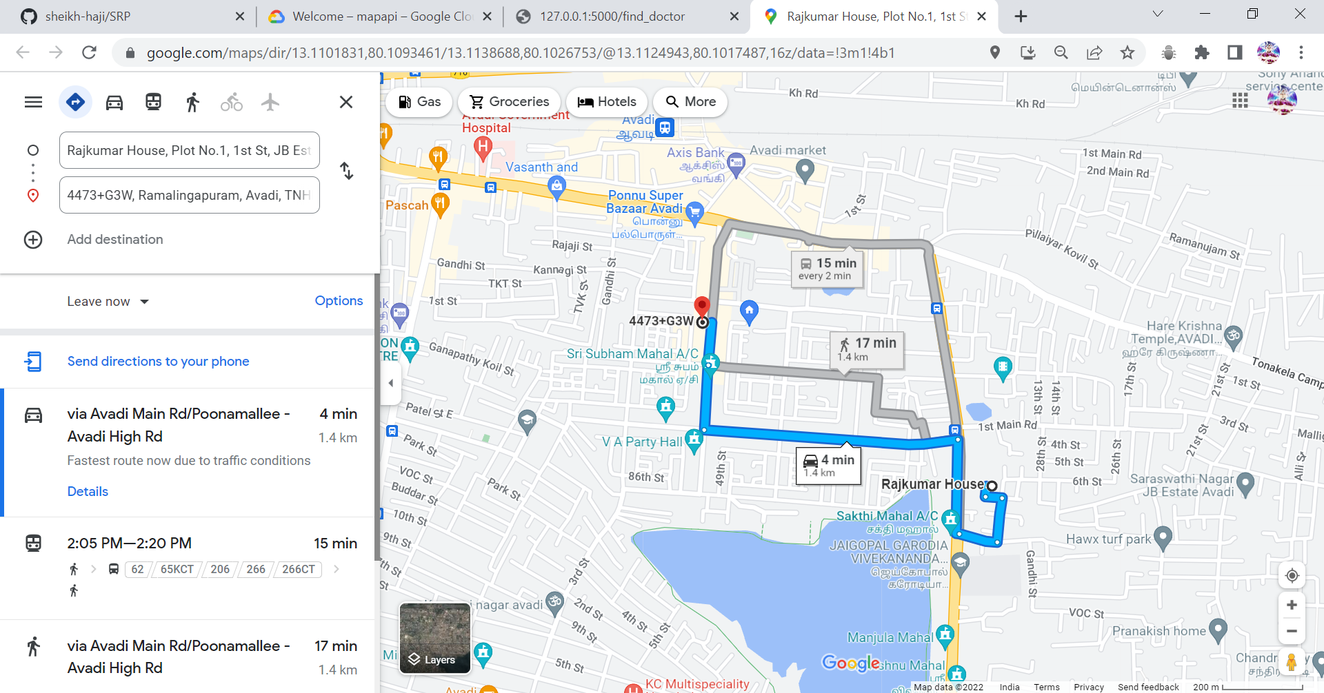
If you click the marker it show directions using standard google maps

Slide 12
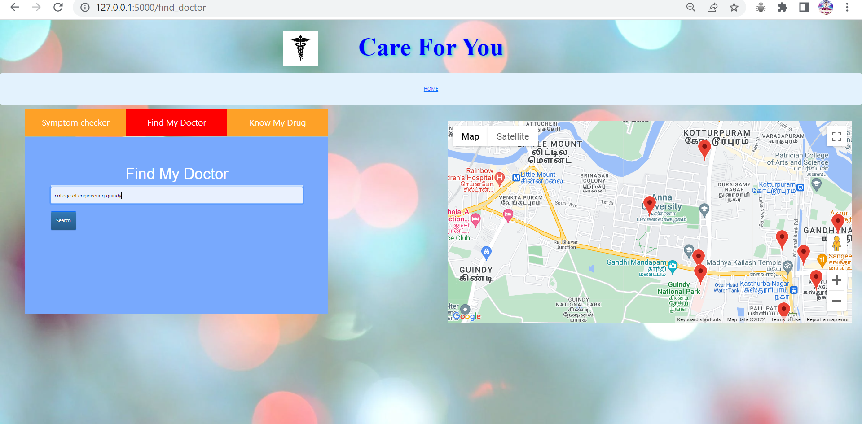
In search Tab you can give custom places and get all near hospitals at the radius of 4km

Slide 13
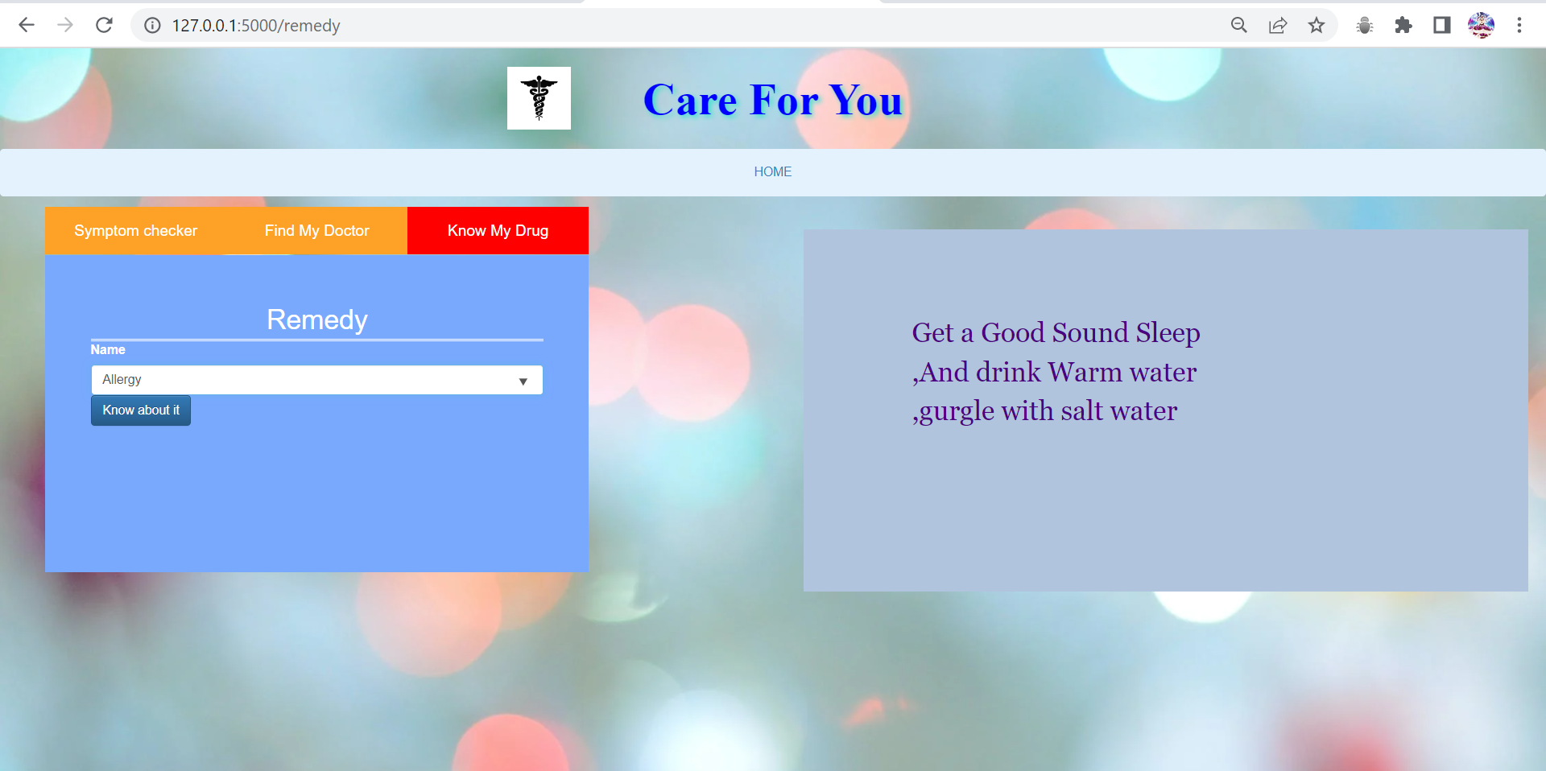
Remedy of Diseases

Slide 14
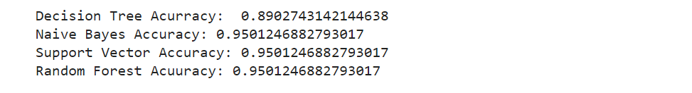
OUTCOME
Based on the Given symptoms the Model classifies the disease based on the symptoms given
The accuracy of the models is given below→
The project also finds the nearest doctor using google js API and google geocoding API, Places API, Geolocation API
Hosted in GCP →
https://mapapi-352916.el.r.appspot.com

